Slide 1
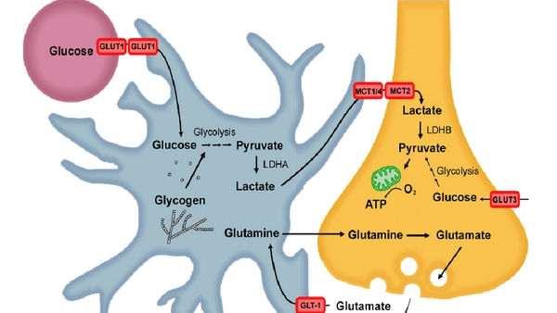
Astrocyte-neuron transport is required for long-term memory formation
T. Newington, Jordan & Harris, Richard & Cumming, Robert. (2013). Reevaluating Metabolism in Alzheimer's Disease
from the Perspective of the Astrocyte-Neuron Lactate Shuttle Model. Journal of Neurodegenerative Diseases. 2013.

Slide 2
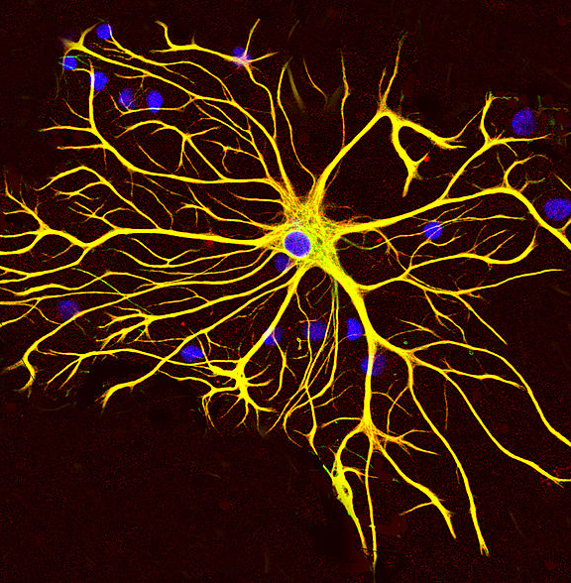
Introduction
glycogen reserve,
part of BBB,
regulation of ion concentration,
metabolic support to neurons etc.
Source: Wikipedia

Slide 3
Important actors
Lactate and glycogen
MCT1/2/4
Inhibitors: DAB and antisense Oligodeoxynucleotides (ODNs)
➔ ODNs bind complementary to mRNA and inhibit it

Slide 4
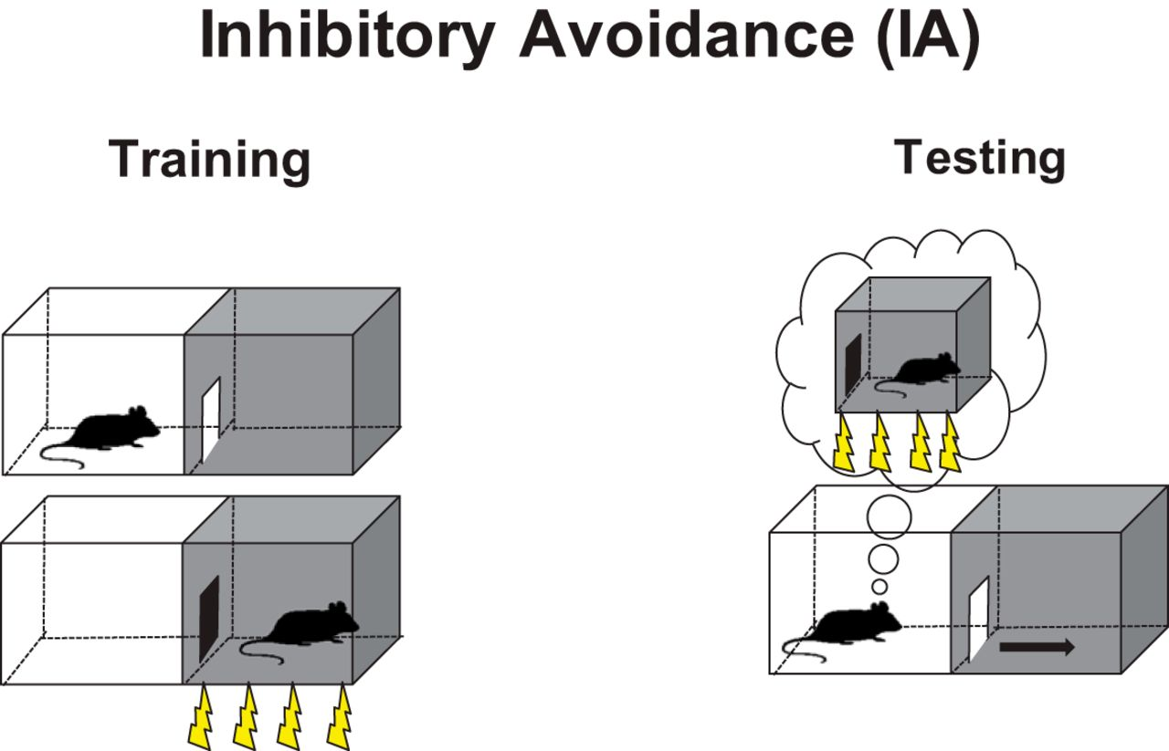
Inhibitory avoidance test
Source: Cristina M. Alberini and Alessio Travaglia (2017). Infantile Amnesia: A Critical Period of Learning to Learn and Remember

Slide 5
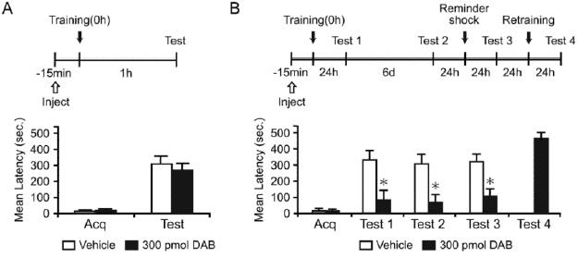
DAB disrupts long-term memory

Slide 6
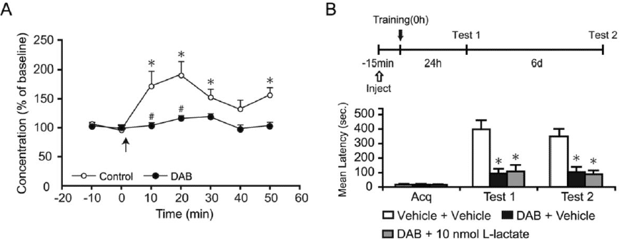
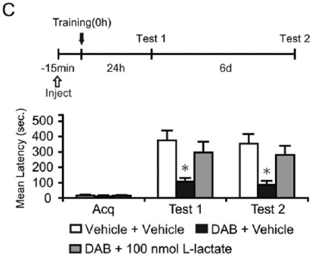
L-lactate recovers normal phenotype

Slide 7
The importance of MCTs
MCT1 is upregulated during long-term memory formation
Loss of MCT1 leads to amnesia
MCT2/4 are needed for lactate transport too

Slide 8
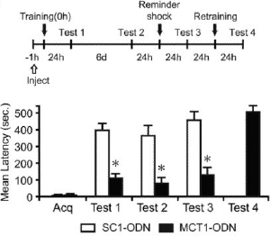
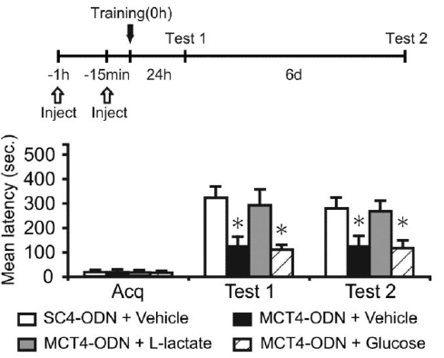
Loss of MCT1 and MCT4
Loss of MCT1
Loss of MCT4

Slide 9
Further mechanisms
Training induces Arc, pcofilin and pCREB
DAB blocks their transcription, but lactate rescues the loss

Slide 10
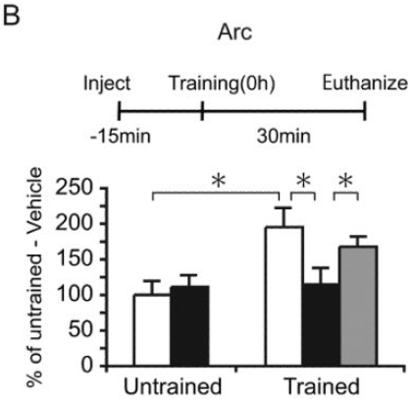
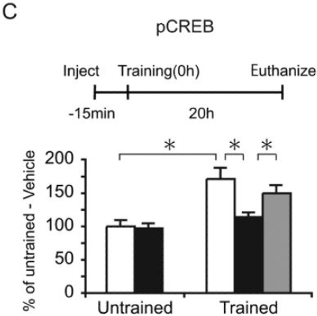
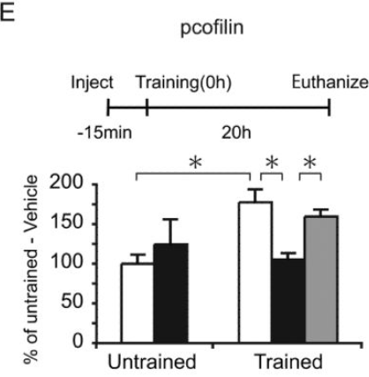
Arc, pCREB, pcofilin

Slide 11
Conclusion
Thus, we have shown:
Astrocytes support neurons
Lactate is needed for long-term memory formation
MCT1 needed and upregulated during memory formation as well as MCT4/2
NEW (in 2011): learning depends on glycogenolysis-dependent lactate release

Slide 12
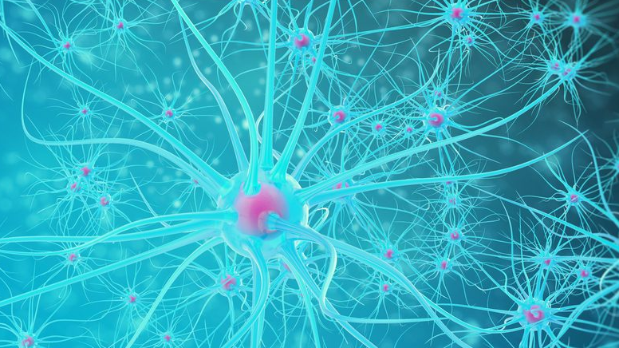
Thank you for your attention

